Slide 1
Final project:
CI/CD pipeline
Zoe Holubkova,
EPAM DevOps external course

Slide 2

Some facts about me:
I’m fast-learning person and I’m passionate about learning something new.
And IT sphere helps me with this.

Slide 3
Relevance:
I’ve chosen Django because its extremely scalable. Also web apps whose development are easy to manage and that can handle big amount of requests are in demand today
Goal:
Automate process of test and deployment as much as possible
Personally for me also is a goal to dive into CI/CD tools

Slide 4
Technology stack
Github
AWS
Jenkins
Docker
Terraform
Ansible

Slide 5








Project scheme

Slide 6
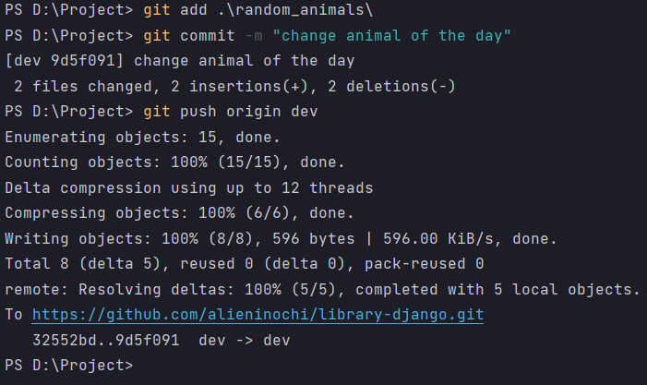
Realization
At first, we make commit of our code and make push to Github:

Slide 7
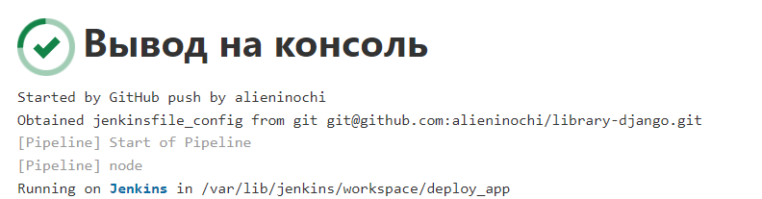
For Jenkins job I’ve used pipeline script. Build triggers were made via webhook, when we push some code to Github:

Slide 8
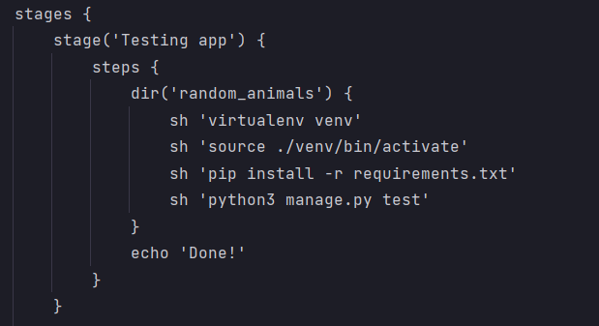
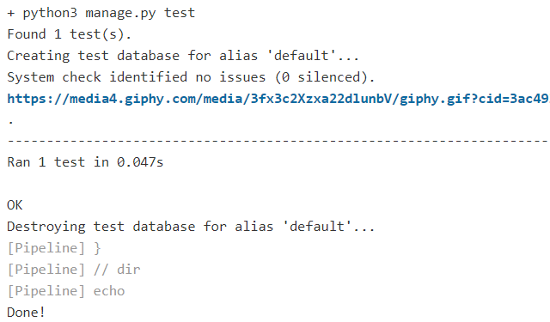
Next step is create virtual environment for app and run some unittests.

Slide 9
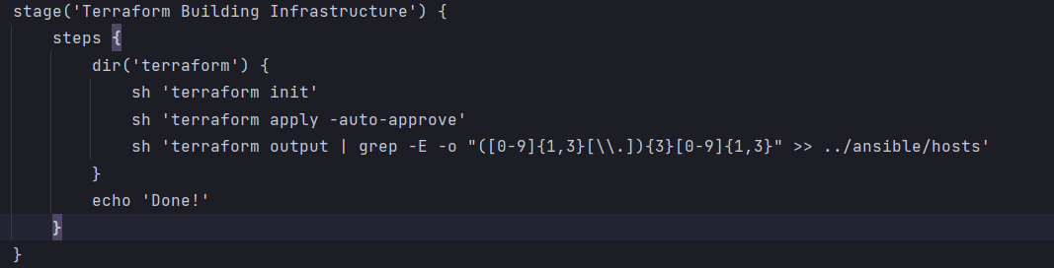
If tests were successful, Jenkins goes to next stage, where Terraform start to build infrastructure:

Slide 10
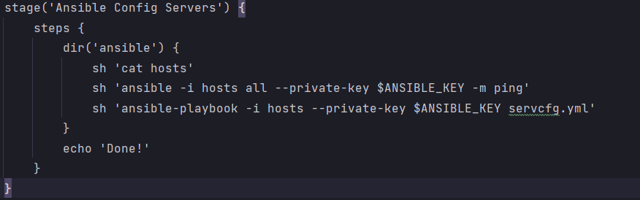
When all necessary units is up, Ansible comes into play with its playbooks. With playbook we configure our instance – we need to install Docker:

Slide 11
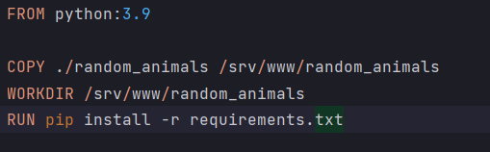
Dockerfile for app:

Slide 12
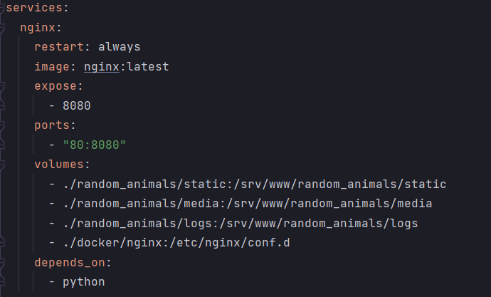
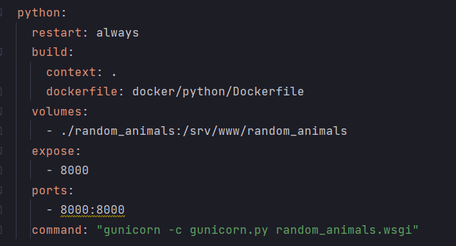
docker-compose file:

Slide 13
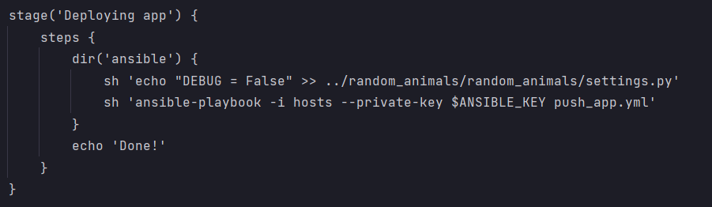
Last stage is deployment of app on the server. Here I also use Ansible playbook for copying files for app and Docker:

Slide 14
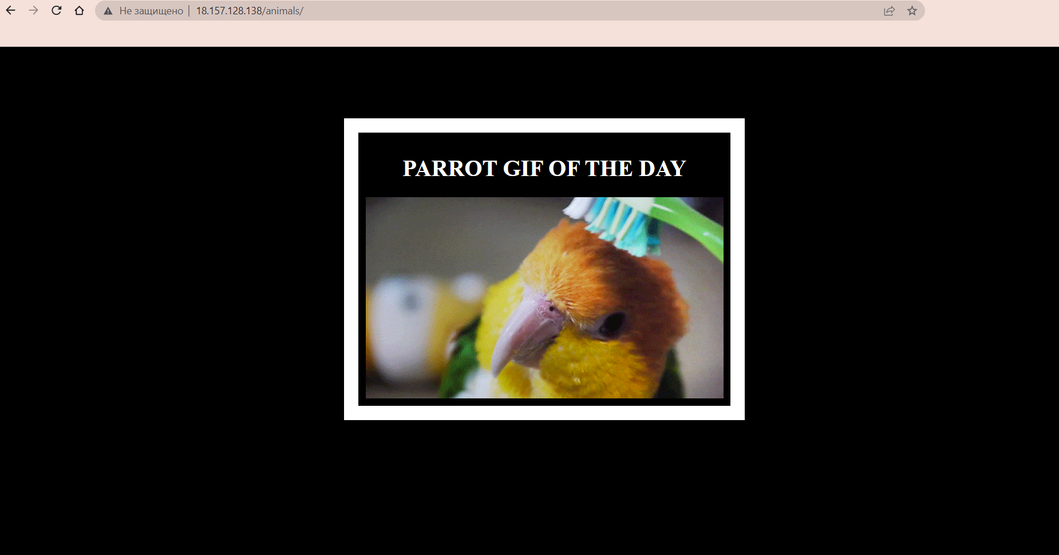
And finally we can access our app

Slide 15
Live demonstration

Slide 16
Thank you for your attention!

